Slide 1
Section 6.1
Generating Functions

Slide 2
Generating Function: an algebraic method to handle special constraints in selection and distribution problems with repetition.
Suppose a_{r} is the number of ways to select r objects from n objects.
g(x) is a generating function for a_{r} if the polynomial expansion of g(x) is
A generating function with an infinite number of terms in its expansion is called a POWER SERIES

Slide 3
History of generating function (from Wikipedia)
In mathematics, a generating function is a way of encoding an infinite sequence of numbers (a_{n}) by treating them as the coefficients of a formal power series. This series is called the generating function of the sequence. Unlike an ordinary series, the formal power series is not required to converge: in fact, the generating function is not actually regarded as a function, and the "variable" remains an indeterminate. Generating functions were first introduced by Abraham de Moivre, a French mathematician, in 1730, in order to solve the general linear recurrence problem. One can generalize to formal power series in more than one indeterminate, to encode information about infinite multi-dimensional arrays of numbers.

Slide 4
The generating function for the binomial coefficients is:
since its polynomial expansion is:
so that, for any r, the coefficient of x^{r} in the expansion of g(x) is:

Slide 5
From this set, let’s choose a subset, for example, 2 out of the 3 objects. For this subset we have 3 possibilities, or or .
These subsets can be represented like this:
Not in subset
In the subset
The polynomial expands to: (Generating Function)
This shows that there are three ways to choose 2 objects from 3 objects.

Slide 6
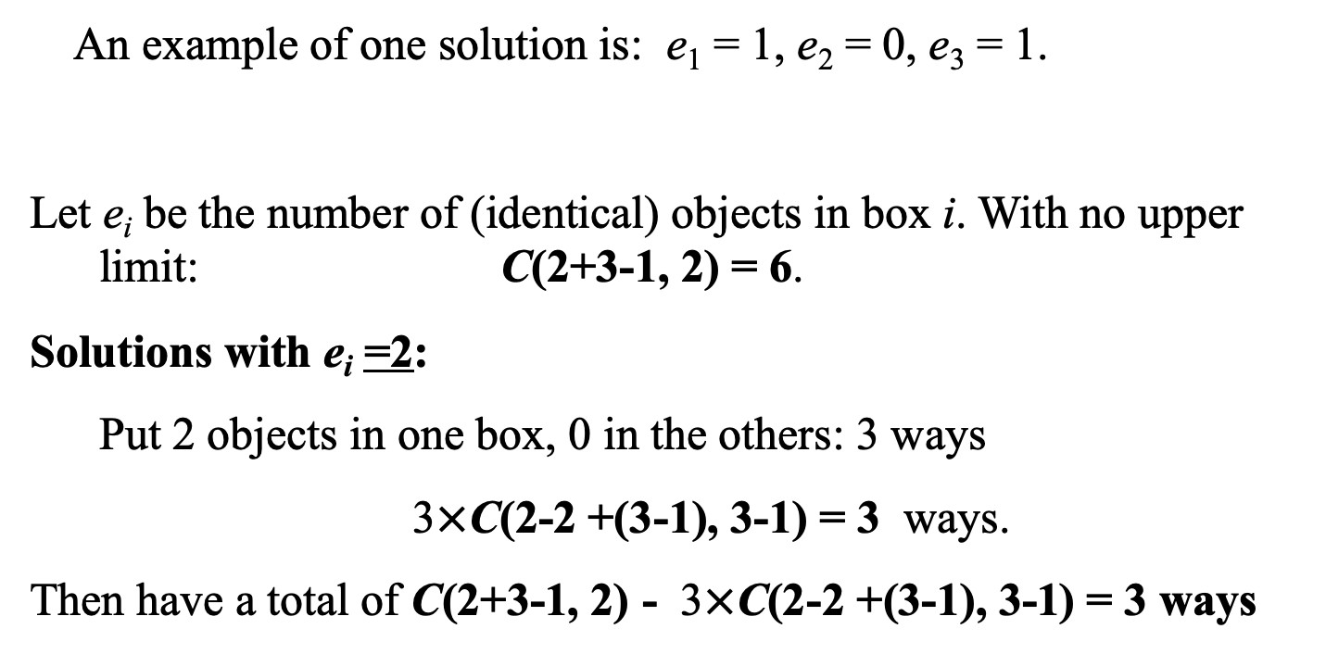
Example 1 (equivalent approach)
How many integer solutions are there to the equation
e₁ + e₂ + e₃ = 2, with 0≤e_{i} ≤ 1?
An example of one solution is: e₁ = 1, e₂ = 0, e₃ = 1.
Let e_{i} be the number of (identical) objects in box i. With no upper limit: C(2+3-1, 2) = 6.
Solutions with e_{i} =2:
Put 2 objects in one box, 0 in the others: 3 ways
3$×$C(2-2 +(3-1), 3-1) = 3 ways.
Then have a total of C(2+3-1, 2) - 3$×$C(2-2 +(3-1), 3-1) = 3 ways
2 identical objects
Box 1 Box 2 Box 3

Slide 7
Example 2
Find the generating function for a_{r,} the number of way to select r balls from a pile of three green, three white, three blue, and three gold balls.
This is modeled as the number of integer solutions to

Slide 8
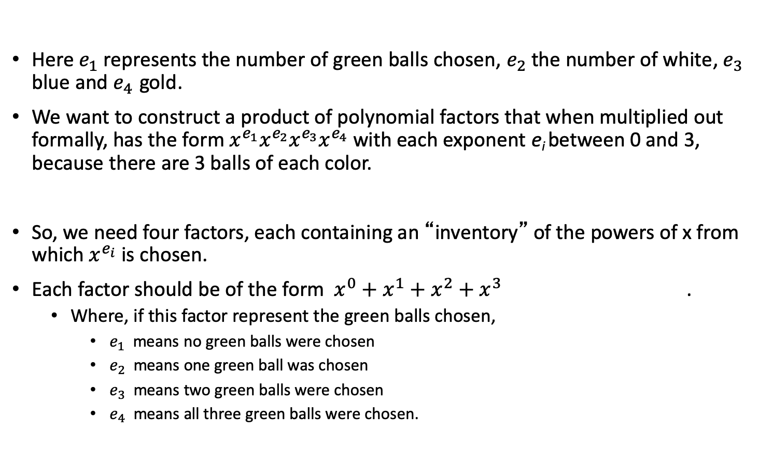
Example 2 (cont)
Here $e_{1}$represents the number of green balls chosen, $e_{2}$ the number of white, $e_{3}$ blue and $e_{4}$ gold.
We want to construct a product of polynomial factors that when multiplied out formally, has the form $x^{e_{1}}x^{e_{2}}x^{e_{3}}x^{e_{4}}$ with each exponent e_{i} between 0 and 3, because there are 3 balls of each color.
So, we need four factors, each containing an “inventory” of the powers of x from which $x^{e_{i}}$ is chosen.
Each factor should be of the form $x^{0}+x^{1}+x^{2}+x^{3}$ .
Where, if this factor represent the green balls chosen,
$e_{1}$ means no green balls were chosen
$e_{2}$ means one green ball was chosen
$e_{3}$ means two green balls were chosen
$e_{4}$ means all three green balls were chosen.

Slide 9
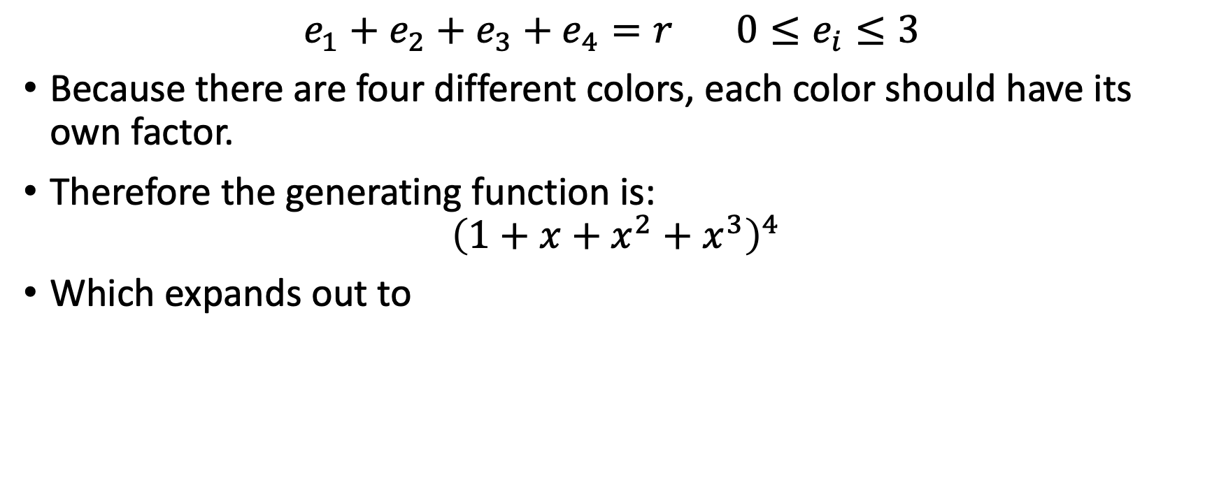
Example 2 (cont)
$$e_{1}+e_{2}+e_{3}+e_{4}=r 0≤e_{i}≤3$$
Because there are four different colors, each color should have its own factor.
Therefore the generating function is:
$${\left(1+x+x^{2}+x^{3}\right)}^{4}$$
Which expands out to

Slide 10
Example 1 (cont). Let’s suppose we modify the original question so that we are going to pick 6 balls.
We can use this equation to find out how many ways there are to pick 6 balls.
Since each coefficient represents the number picked, we use the coefficient of 6. (44 ways).
Think about what goes into getting a factor of
Can have any combination, such as 2 greens, 3 blues, 1 gold:
represents that combination.

Slide 11
In General
If
You will get a factor:
If
You will get a factor:
which continues forever

Slide 12
Example 3

Slide 13
Class Problem 1:
Build a generating function for a_{r}, the number of integer solutions to the equation:

Slide 14
Class Problem 2:
Build a generating function for a_{r}, the number of r selections from a pile of:
Five Jelly beans, three licorice sticks, eight lollipops with at least one of each candy.

Slide 15
Class Problem :
Build a generating function for the number of integer solutions to:
e₁ +e₂ +e₃ +e₄ = r, 0 ≤ e₁ ≤ e₂ ≤ e₃ ≤ e₄,

Slide 16
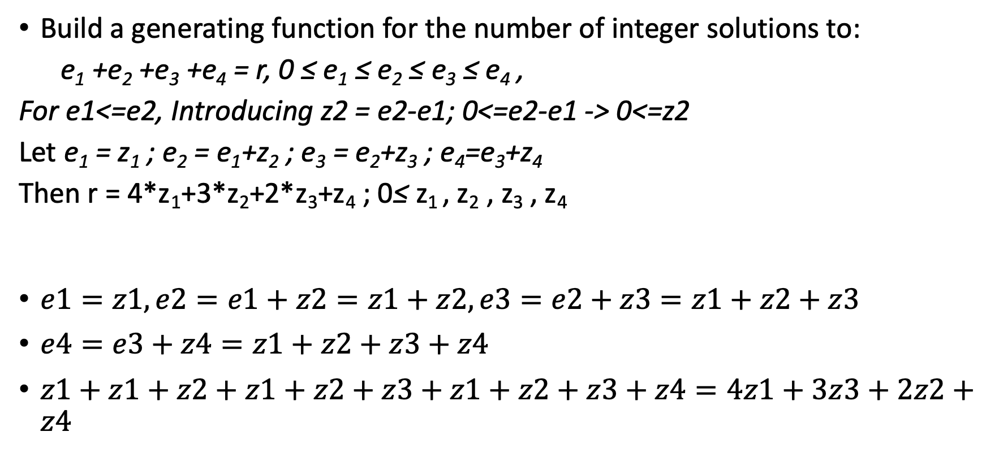
Class Problem :
Build a generating function for the number of integer solutions to:
e₁ +e₂ +e₃ +e₄ = r, 0 ≤ e₁ ≤ e₂ ≤ e₃ ≤ e₄ ,
For e1<=e2, Introducing z2 = e2-e1; 0<=e2-e1 -> 0<=z2
Let e₁ = z₁ ; e₂ = e₁+z₂ ; e₃ = e₂+z₃ ; e₄=e₃+z₄
Then r = 4*z₁+3*z₂+2*z₃+z₄ ; 0≤ z₁ , z₂ , z₃ , z₄
$e1=z1, e2=e1+z2=z1+z2, e3=e2+z3=z1+z2+z3$
$e4=e3+z4=z1+z2+z3+z4$
$z1+z1+z2+z1+z2+z3+z1+z2+z3+z4=4z1+3z3+2z2+z4$

Slide 17
Class Problem :
Build a generating function for a_{r} , the number of integer solutions to the following equations:
(a) e₁ +e₂ +e₃ +e₄ +e₅ = r, 0 ≤ e_{i} ≤ 5
(b) e₁ +e₂ +e₃ = r, 0 < e_{i} < 6
(c) e₁ +e₂ +e₃ +e₄ = r, 2 ≤ e_{i} ≤ 7 ; e₁ even; e₂ odd
(d) e₁ +e₂ +e₃ +e₄ = r, 0 ≤ e_{i}
(e) e₁ +e₂ +e₃ +e₄ = r, 0 < e_{i} ; e₂ , e₄ odd; e₄ ≤ 3

Slide 18
(a) e₁ +e₂ +e₃ +e₄ +e₅ = r, 0 ≤ e_{i} ≤ 5

Slide 19
(c) e₁ +e₂ +e₃ +e₄ = r, 2 ≤ e_{i} ≤ 7 ; e₁ even; e₂ odd

Slide 20
(d) e₁ +e₂ +e₃ +e₄ = r, 0 ≤ e_{i}

Slide 21
(e) e₁ +e₂ +e₃ +e₄ = r, 0 < e_{i} ; e₂ , e₄ odd; e₄ ≤ 3

Slide 22
Class Problem :
Build a generating function for a_{r} , the number of distributions of r identical objects into
(a) Five different boxes with at most three objects in each box
(b) Three different boxes with between three and six objects in each box
(c) Six different boxes with at least one object in each box
(d) Three different boxes with at most five objects in the first box

Slide 23
Class Problem :
Build a generating function for a_{r} , the number of distributions of r identical objects into
Five different boxes with at most three objects in each box

Slide 24
Class Problem :
Build a generating function for a_{r} , the number of distributions of r identical objects into
(d) Three different boxes with at most five objects in the first box

Slide 25
Class Problem :
Use a generating function for modeling the number of 5-combinations of the letters M, A, T, H in which M and A can appear any number of times but T and H appear at most once. Which coefficient in this generating function do we want?

Slide 26
Class Problem :
Use a generating function for modeling the number of 5-combinations of the letters M, A, T, H in which M and A can appear any number of times but T and H appear at most once. Which coefficient in this generating function do we want?

Slide 27
Class Problem :
A national singing contest has five distinct entrants from each state. Use a generating function for modeling the number of ways to pick 20 semifinalists if
(a) There is at most one person from each state.

Slide 28
Class Problem :
A national singing contest has five distinct entrants from each state. Use a generating function for modeling the number of ways to pick 20 semifinalists if
(a) There is at most one person from each state.
since there are 5 choices for each one

Slide 29
Class Problem :
A national singing contest has five distinct entrants from each state. Use a generating function for modeling the number of ways to pick 20 semifinalists if
(b) There are at most three people from each state.

Slide 30
Class Problem :
A national singing contest has five distinct entrants from each state. Use a generating function for modeling the number of ways to pick 20 semifinalists if
(b) There are at most three people from each state.

